Slide 1
TrustChain: Building Trust with Distributed Ledgers
Martijn de Vos, Johan Pouwelse and Dick Epema
Notes:
Good afternoon everyone,
I am Martijn de Vos and today I present our recent work on the Trustchain, a distributed blockchain-based ledger that can be used to build trust.

Slide 2
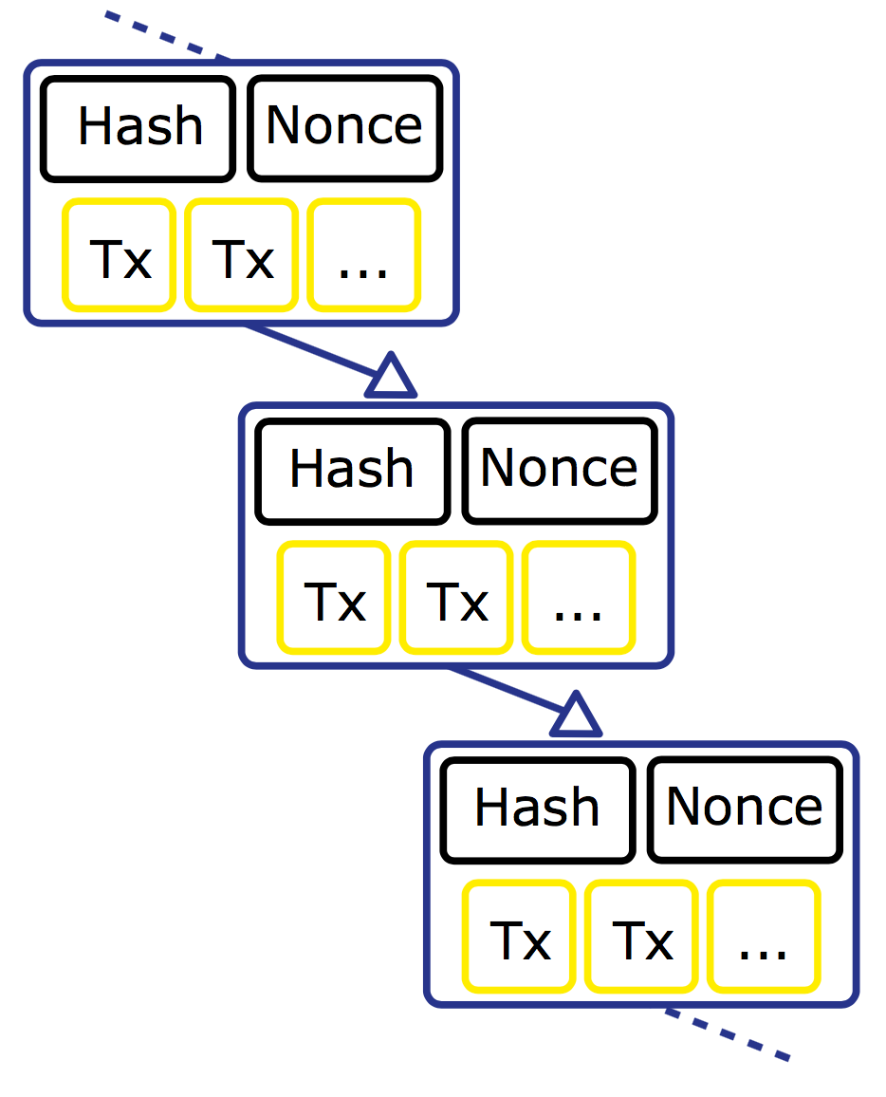
What is a blockchain? (1/2)
A chained data structure to store transactions
Chain of blocks
Each record contains a hash of the previous record
Tamper-proof
Notes:
Before explaning the architecture of TrustChain, I will shortly explain what a blockchain exactly is. In essence, a blockchain is a chained data structure to store transaction. An example of a blockchain can be seen in the figure on the right side. This figure shows a chain that consists of three blocks. Each block contains information about one or more transactions. In addition, each block contains a hash of the previous block, making the structure tamper-proof since one cannot easily modify a historical block.

Slide 3
What is a blockchain? (2/2)
Applications
Cryptocurrency: Bitcoin, Litecoin
Smart contracts: Ethereum
Problems
Scalability: transaction throughput of Bitcoin is bounded
Storage: blockchains can grow large
Notes:
There exist various applications that use blockchain as their underlying core structure. For instance, cryptocurrency like Bitcoin and litecoin. Applications like Ethereums use the blockchain to store digital contractual agreements, also called smart contracts.
However, there are various problems of traditional blockchain application. First of all, they are often not scalable. For instance, the transaction throughput of Bitcoin is limited to around seven transactions per second. In addition, blockchains can grow large, allocating large amounts of disk space if users want to verify the validity of a chain.

Slide 4
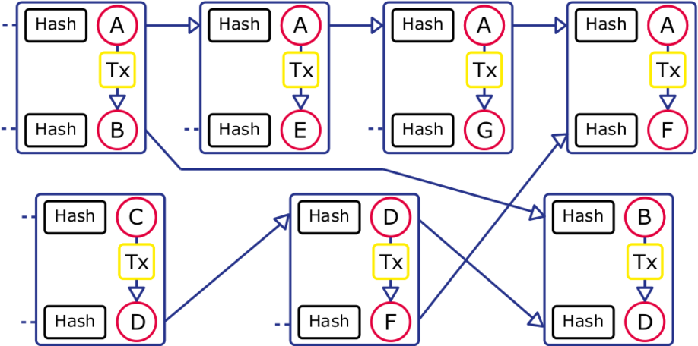
TrustChain
Notes:
This pictures illustrates the architecture of TrustChain. Compared to the Bitcoin blockchain where there is only one, shared chain, in TrustChain every user maintains their own chain of transactions. Each block has two incoming edges and two outgoing edges where one edge points towards the previous block of the user’s chain. The other edge points towards a block in the chain of the other party involved in a transaction. The chains of these two users are now “entangled” to say so. This property makes it harder to tamper with the chains and easier to detect fraudulent operations.
TrustChain also includes a novel Sybil-resistant reputation mechanism that uses the TrustChain graph as input for it’s computation.

Slide 5
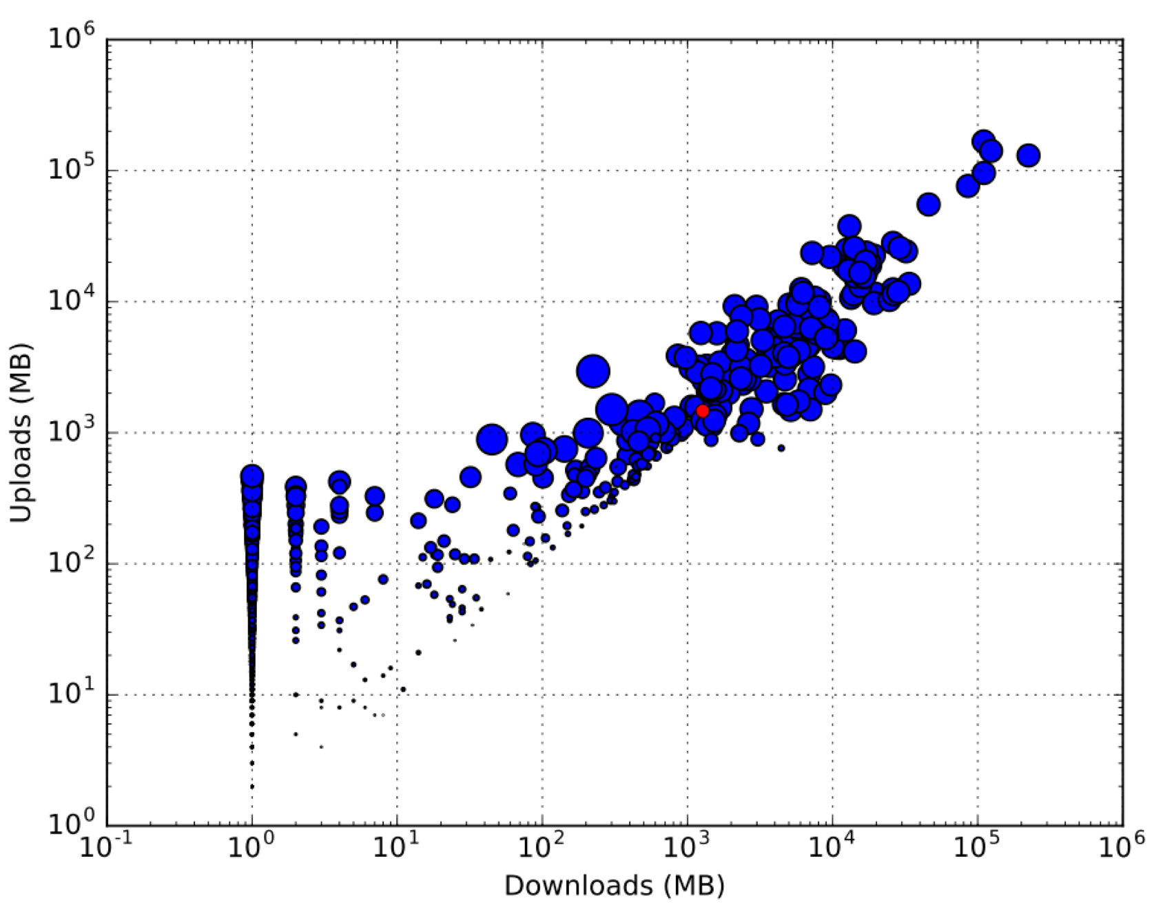
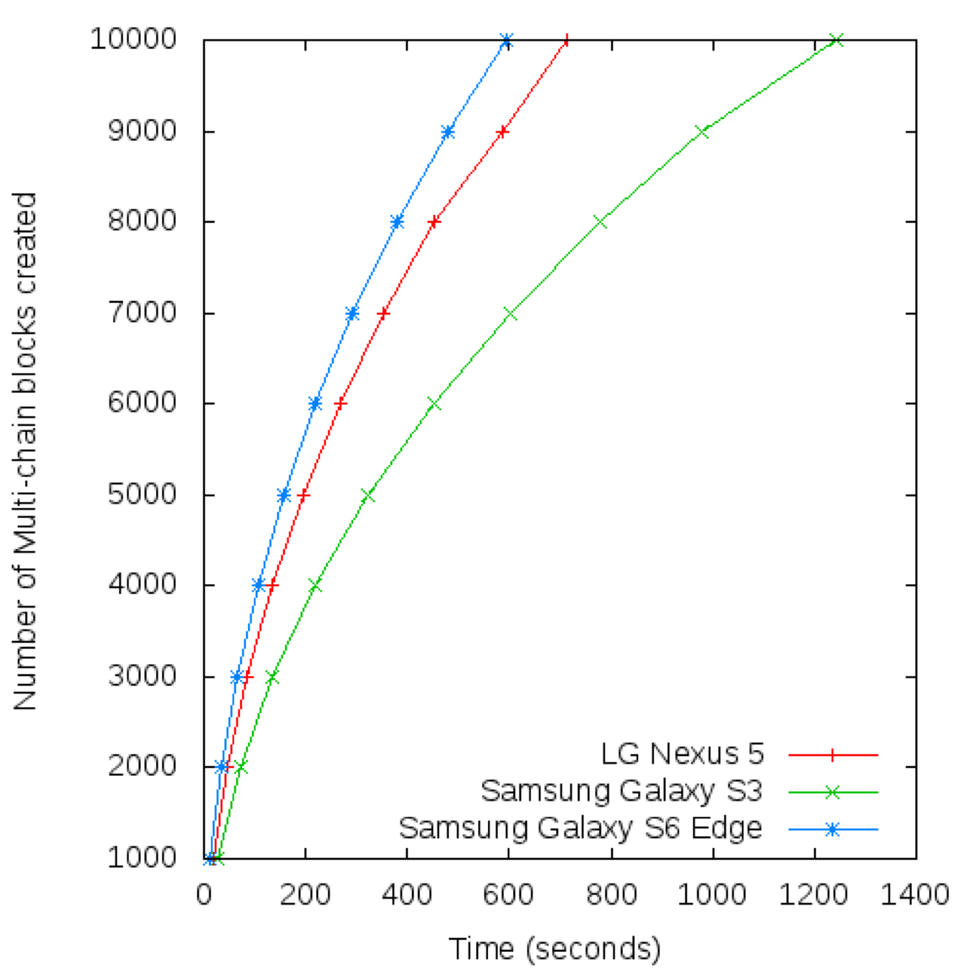
Results
Free-rider detection experiment
Scalability experiment
Notes:
We have implemented TrustChain and integrated in our P2P file-sharing software Tribler where we consider upload and download of files as interactions between users. By using the TrustChain reputation mechanism, we were able to detect free-riders in the network as is somewhat visible in the left figure. The horizontal axis presents the amount of downloaded data and the vertical axis the amount of uploaded data. The size of the bubble is the reputation assigned to a specific user.
Next, we performed a scalability experiment where we determined the amount of TrustChain blocks that can be created over time. We performed this experiment on mobile devices running Android and we concluded that the transaction throughput is higher than traditional blockchain applications. Note that this graph does not consider network latency between users.
Our current research is focussed on using TrustChain to build a decentralized market which supports general asset trading. In addition, we are currently building a consensus algorithm on top of TrustChain so if you want to know more about this, please visit me at the poster and we can have a talk.
Thank you for your attention.

